Slide 1

TABLEAU
REINFORCEMENT PRESENTATION
FOUR WHEELER ANALYSIS
VASANTH MG
OCTOBER 2024 BATCH
DA AND DS
13-02-2025

Slide 2
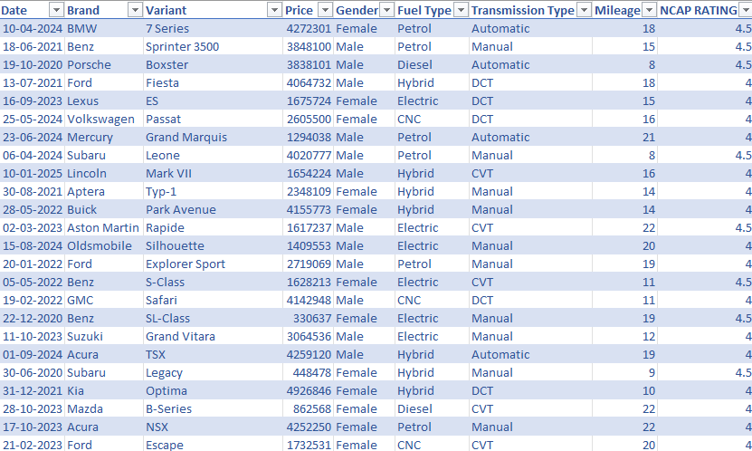
DATASET OVERVIEW
REMOVED DUPLICATES
ADDED NEW COLOUMN
REPLACED NULL VALUES

Slide 3
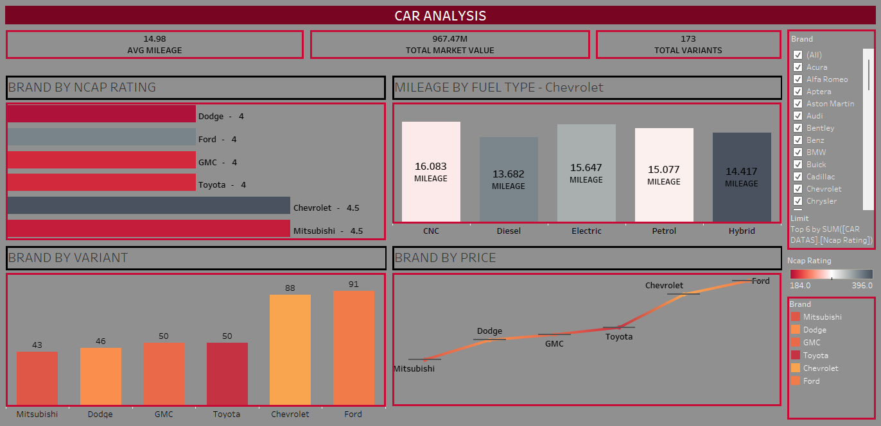
DASHBOARD OVERVIEW

Slide 4
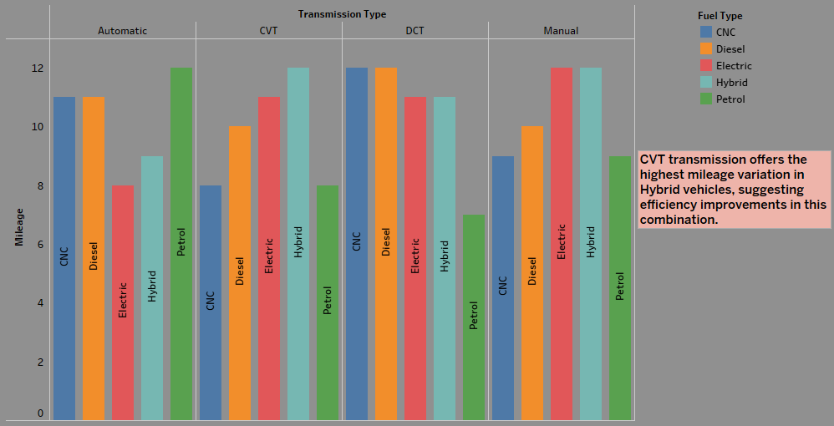
TABLEAU STORY

Slide 5
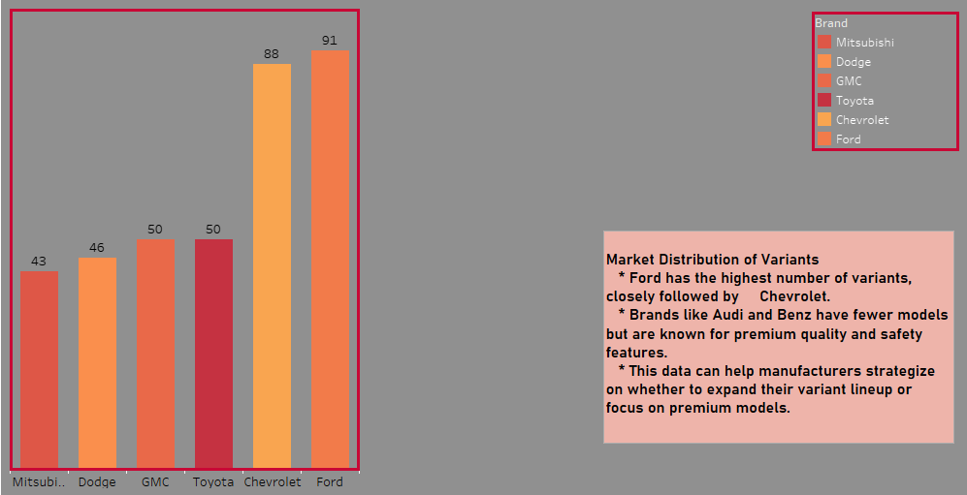
TABLEAU STORY

Slide 6
KEY INSIGHTS
Ford has the highest number of variants, followed by Chevrolet and Dodge.
Volkswagen and Mitsubishi have fewer models but steady demand.
Recommendation:
Brands with fewer variants should focus on niche segments (e.g., sports cars, luxury SUVs).
Hybrid cars have the best average mileage, followed by Electric, Petrol, and Diesel.
CNC fuel type has the lowest efficiency, making it less attractive to cost-conscious buyers
Recommendation:
Automakers should increase investment in EV and Hybrid models to stay ahead in the green mobility trend.

Slide 7
CONCLUSION
Investment in Hybrid & Electric Vehicles is essential for long-term growth.
Enhancing safety features in mid-range brands can increase customer trust and market share.
Luxury brands should expand their model lineup to capture a wider audience.
THANK YOU

